Slide 1


Predicting 30-Day Diabetes Readmissions
Abdullah Abdul Sam| Feifan Liu | Jiahao Li
MSDS 422 – Practical Machine Learning | Final Project – Milestone 2

Slide 2



Hospitals Face Financial and Operational Strain from Preventable Diabetes Readmissions
Business Problem
Business Objective
Decision Question
●
Financial penalties and operational burden from 30-day diabetes readmissions
●
Develop ML model to predict 30-day readmission risk
●
Which diabetes patients need additional intervention at discharge?
●
Enable prioritization of enhanced discharge planning
●
Many readmissions are preventable with targeted interventions
●
Goal: Reduce likelihood of readmission within 30 days
●
Support targeted post-discharge follow-up
●
Hospitals lack capability to identify high-risk patients at discharge

Slide 3
Analysis Draws from 101,766 Inpatient Encounters Across 130 U.S. Hospitals
Dataset Overview
Feature Categories
●
UCI Diabetes 130-US Hospitals (1999–2008)
●
Demographics: Age, gender, race
●
Admission details: Type, source, disposition, length of stay, specialty
●
101,766 inpatient encounters
●
130 U.S. hospitals
●
Clinical metrics: Lab procedures, medications, diagnoses, prior visits
●
55 original features
●
Laboratory results: Glucose serum, HbA1c tests
●
Medications: 24 diabetes drugs with dosage change indicators

Slide 4


Severe Class Imbalance Requires Specialized Evaluation Beyond Accuracy Metrics
Target Variable Construction
Class Distribution
Evaluation Implications
●
Positive class: 11.2%
●
Accuracy-based metrics would be misleading
●
Binary classification: readmit_binary = 1 (within 30 days) vs. 0 (no readmission or after 30 days)
●
Negative class: 88.8%
●
Imbalance ratio: ~7.2:1
●
Primary evaluation: AUROC
●
Secondary metrics: Recall and precision for clinical utility

Slide 5

Missing Data Patterns Reflect Clinical Practice and Provide Predictive Signal
High-Missingness Features (Dropped)
●
Weight: ~97% missing
●
Payer code: ~52% missing
Both exceed acceptable thresholds
Clinically Meaningful Missingness (Retained)
●
Medical specialty: ~47% (encoded as 'Unknown')
●
Glucose serum test: >80% missing
●
HbA1c test result: >83% missing
Key Insight
●
Lab test missingness >80% reflects clinical practice, not data quality issues
●
Absence of tests carries predictive information about patient risk profiles
●
Retained as categorical signal rather than imputed or removed

Slide 6




Patient Demographics Show Age Concentration and Racial Skew
Age Distribution
Gender & Race
Length of Stay
Majority fall within 60–80 age range, reflecting typical diabetes demographics
Gender: Approximately balanced. Race: Skewed toward Caucasian patients, raising generalizability concerns
Right-skewed distribution with typical stays of 2–4 days
Medication Burden
Most patients receive 10–20 medications, indicating widespread polypharmacy. Prior utilization shows long right tails identifying high-risk subgroups

Slide 7
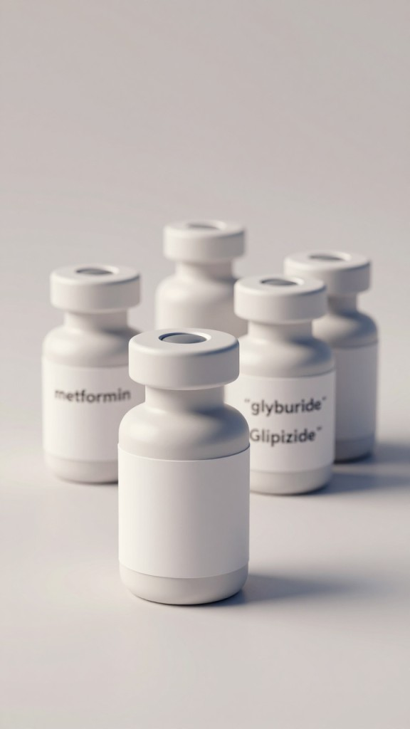
Insulin Dominates Medication Changes, Signaling Treatment Complexity
Medication Change Analysis
Clinical Interpretation
●
High medication volatility reflects treatment complexity and unstable glycemic control
●
Insulin: >20,000 dosage changes (dramatically highest)
Oral agents (metformin, glyburide, glipizide): substantially lower frequencies
●
Frequent dosage adjustments indicate disease severity
●
●
Medication change history is a strong predictor of readmission risk
●
Clear separation between insulin and other diabetes medications

Slide 8


EDA Summary: Readmission Risk Correlates with Utilization Intensity and Treatment Complexity
Key Findings
Missingness Insight
Feature Engineering Implications
Modeling Implications
●
Readmission patterns strongly associate with healthcare utilization intensity
●
Missing lab results provide predictive signal rather than representing data quality issues
●
Handle non-linear interactions between clinical variables
●
Capture utilization intensity and medication complexity metrics
●
Medication burden and dosage volatility signal treatment complexity
●
Prioritize clinically relevant metrics over accuracy
●
Absence patterns reflect clinical decision-making and patient risk profiles
●
Encode missing lab results as categorical features
●
Account for class imbalance in evaluation framework
●
Length of stay and diagnosis count reflect acute illness severity
Develop prior engagement pattern indicators
●

Slide 9
Data Preparation Balances Clinical Validity with Statistical Rigor
Preprocessing Strategy
Feature Engineering
●
Remove hospice and deceased discharges (not valid candidates)
●
Construct medication burden indicators
●
Engineer medication change frequency metrics
●
Retain only first encounter per patient (prevent data leakage)
Develop utilization intensity scores from prior visit patterns
●
●
Drop high-missingness features: weight, payer_code
●
Impute race using mode
●
Encode missing medical_specialty as 'Unknown'
●
Preserve lab test non-performance as categorical information
~70,000
~77
11%
Final Encounters
Total Features
Positive Class Rate

Slide 10



Model Development Strategy Prioritizes Interpretability and Clinical Deployability
Planned Models
Evaluation Framework
Deployment Concept
●
Logistic Regression: Baseline, maximum interpretability
●
Primary metric: AUROC (area under ROC curve)
●
Real-time readmission risk scoring at discharge
●
Random Forest: Capture non-linear interactions
●
Secondary metrics: Recall and precision for clinical feasibility
●
Flag high-risk patients for enhanced interventions
●
XGBoost: Expected strongest performer, handles class imbalance
●
Calibration analysis: Ensure predicted probabilities reflect true risk
●
Enable care coordination and medication reconciliation
●
Deep Neural Network: Exploratory complex pattern detection
●
Support accelerated follow-up scheduling

Slide 11
Next Steps: Model Training, Validation, and Clinical Impact Assessment
Milestone 3 Deliverables and Final Project Components

Slide 12
Milestone 3: Immediate Next Steps and Final Deliverable Components
Complete Data Preparation
1
Finalize feature engineering and prepare cleaned dataset with ~77 features for model training
2
Train and Tune Models
Implement Logistic Regression, Random Forest, XGBoost, and Deep Neural Network with hyperparameter optimization
Conduct Comparative Analysis
3
Evaluate models using AUROC, recall, and precision; perform calibration analysis and threshold optimization
4
Develop Clinical Framework
Build clinical decision framework for intervention prioritization and interpretability analysis
Final Deliverable
5
Model performance results, feature importance analysis, clinical implementation recommendations, deployment architecture, and limitations assessment

Slide 13

Thank You
Questions and Discussion Welcome

